Slide 1




ISA 401: Business Intelligence & Data Visualization
02: Introduction to
Fadel M. Megahed, PhD
Raymond E. Gloss Professor in Business Farmer School of Business
Miami University
@FadelMegahed fmegahed fmegahed@miamioh.edu
Automated Scheduler for Office Hours
Fall 2025

Slide 2
Quick Refresher from Last Class
✅ Describe course objectives & structure
✅ Define data visualization & describe its main goals
✅ Describe the BI methodology and major concepts
2 / 51

Slide 3
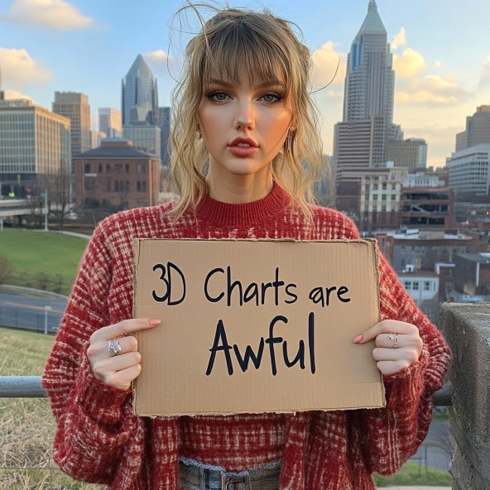
Quick Refresher from Last Class
Note: Image generated using Midjourney AI v6.1 on Aug 27, 2024. I used the following prompt: Taylor Swift holding a sign that says "3D Charts are Awful" with Cincinnati skyline in the background.
3 / 51

Slide 4
Learning Objectives for Today's Class
Describe why we are using in this course?
Understand the syntax, data structures and functions.
Utilize the project workflow in and create your first script.
4 / 51

Slide 5
55 // 5511

Slide 6
Pedagogy Behind Using in this Course
crashes =
reading the data directly from the source
readr::read_csv("https://data.cincinnati-oh.gov/api/views/rvmt-pkmq/rows.csv?accessType=DOWNLOAD") |>
changing all variable names to snake_case janitor::clean_names() |>
selecting variables of interest
dplyr::select(address_x, latitude_x, longitude_x, cpd_neighborhood, datecrashreported, instanceid, typeofperson,
engineering some features from the data dplyr::mutate(
datetime = lubridate::parse_date_time(datecrashreported, orders = "'%m/%d/%Y %I:%M:%S %p", tz = hour = lubridate::hour(datetime),
date = lubridate::as_date(datetime)
'America/New_Y
)


The Beauty of Programming Languages
Programming languages are languages.
It's just text -- which gives you access to two extremely powerful techniques!!!
Source: Content in "The Beauty of Programming Languages" is from Hadley Wickham's You Can't Do Data Science in a GUI
6 / 51

Slide 7



Pedagogy Behind Using in this Course
The Beauty of Programming Languages (Continued)
Ctrl + C
Ctrl + V
In addition, programming languages are generally
Readable (IMO way easier than trying to figure what someone did in an )
Open (so you can it)
Reusable and reproducible (so you can reuse your code for similar problems and other people can get the same results as you easily)
Diffable (version control is extremely powerful)
Source: The bullets in "The Beauty of Programming Languages" are based on Hadley Wickham's You Can't Do Data Science in a GUI
7 / 51

Slide 8

Pedagogy Behind Using
in this Course
Why Specifically?
It is a general-purpose programming language, which originated for statistical analysis.
As of Aug 27, 2025, there are 22,578 packages on CRAN (not including those on ).
The tidyverse group of packages have simplified the workflow for data analytics/science.
8 / 51

Slide 9

How to Learn
(Any Programming Language)
🗣 Get hands dirty‼
📖 Documentation! Documentation! Documentation!
🔍 (Not surprisingly) Learn to Google/ChatGPT/ChatISA: what that error message means(I do that a lot 😂)
Source: Slide is based on Kia Ora's How I Learn a Technology.
9 / 51

Slide 10
TThhee RRSSttuuddiioo IInntteerrffaaccee,, SSeettuupp aanndd aa PPrroojjeecctt OOrriieenntteedd WWoorrkkflflooww ffoorr yyoouurr AAnnaallyyssiiss
1100 // 5511

Slide 11
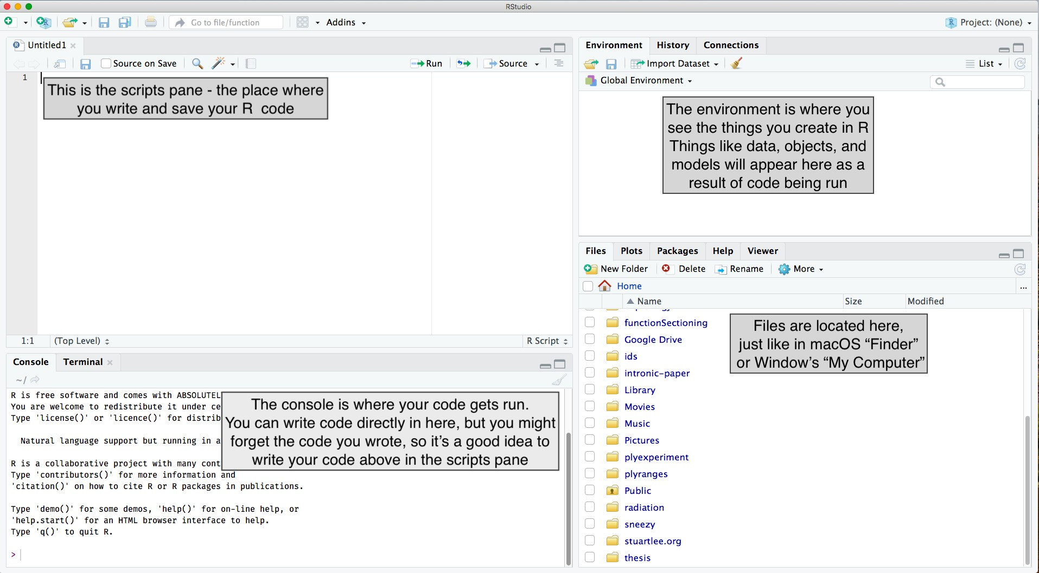
RStudio Interface
image credit: Stuart Lee
11 / 51

Slide 12
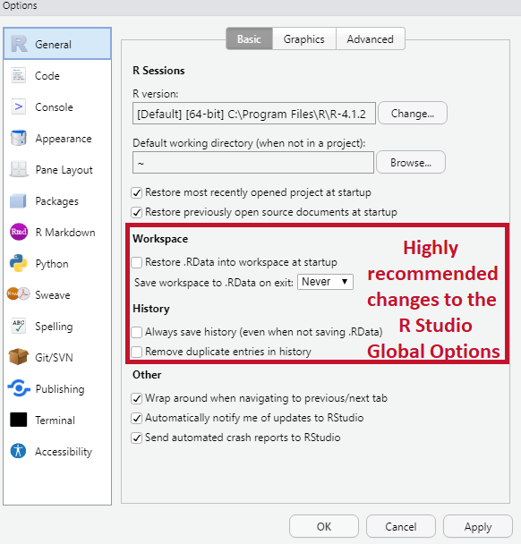
Setting up RStudio (do this once)
Go to Tools > Global Options:
Uncheck Workspace and History, which helps to keep working environment fresh and clean every time you switch between projects.
12 / 51

Slide 13
What is a project?
Each university course is a project, and get your work organised.
A self-contained project is a folder that contains all relevant files, for example my ISA 401/
📂 includes:
isa401.Rproj
lectures/
01_introduction/
01-introduction.Rmd, etc.
02_introduction_to_r/
02_introduction_to_r.Rmd, etc.
All working files are relative to the project root (i.e. isa401/).
The project should just work on a different computer.
13 / 51

Slide 14
110011:: OOppeerraattoorrss
1144 // 5511

Slide 15
Assignment
has three assignment operators: <-, =, and ->, which can be used as follows.
x1 <- 5
x2 = 5
5 -> x3
print(paste0("The values of x1, x2, and x3 are ", x1, ", ", x2, ", and ", x3, " respectively
 
## [1] "The values of x1, x2, and x3 are 5, 5, and 5 respectively"
The assignment consists of three parts:
The left-hand side: variable names (x1 or x2),
The assignment operator: <- (or alternatively =), and
The right-hand side: values (5)
15 / 51

Slide 16
Retrieval
We can retrieve/call the object using its name as follows:
x1
## | [1] | 5
x3
## | [1] | 5
16 / 51

Slide 17
Retrieval: Three Common Errors
Case issue: object names in are case sensitive.
X1 # should be x1 instead of X1 (see last slide)
## Error: object 'X1' not found
Typo: A spelling error of some sort
y3 # should be x3 instead of y3 (see last slide)
## Error: object 'y3' not found
Object not saved: e.g., you clicked Enter instead of Ctrl + Enter when running your code
rm(x2) # removing x2 from the global environment to mimic error x2 # x2 is not in the global environment (see environment)
17 / 51

Slide 18
Arthimetic Operators
While we will not specifically talk about doing math in
, the operators below are good to know.
Operator | Description
+ | addition
- | subtraction
* | multiplication
/ | division
^ or ** | exponentiation
x %% y | modulus (x mod y) 5%%2 is 1
x %/% y | integer division 5%/%2 is 2
Source: The above table is scraped from Quick-R: Operators.
18 / 51

Slide 19
Logical Operators
Logical operators are operators that return TRUE and FALSE values.
Operator | Description
< | less than
<= | less than or equal to
> | greater than
>= | greater than or equal to
== | exactly equal to
!= | not equal to
!x | Not x
**x | y**
x & y | x AND y
isTRUE(x) | test if X is TRUE
Source: The above table is also scraped from Quick-R: Operators.
19 / 51

Slide 20
110011:: SSyynnttaaxx,, DDaattaa TTyyppeess,, DDaattaa SSttrruuccttuurreess aanndd FFuunnccttiioonnss
2200 // 5511

Slide 21
Coding Style
Good coding style is like correct punctuation: you can
manage without it, butitsuremakesthingseasiertoread.
-- The tidyverse style guide
style guide
✅ snake_case
Source: Slide is based on Earo Wang's STAT 220 Slides
21 / 51

Slide 22
is a Vector Language: Sample Output
Learning from a sample of ten obs. from the standard normal distribution (i.e., x ∼ N (0, 1))
x_vec = | rnorm(n=10, | mean = 0, sd = 1) | generating | std normal dist data
x_vec > | 0 # finding | which elements in | x are larger | than 0
## [1] TRUE TRUE TRUE TRUE FALSE FALSE TRUE TRUE FALSE FALSE
sum(x_vec > 0) # summing the number of elements (i.e., how many are > 0)
## [1] 6
If we focus on the obtained outputs, we can see that both are vectors:
x_vec > 0 returns a vector of size 10 (TRUE/FALSE for each element)
sum(x_vec > 0) returns a vector of size 1
22 / 51

Slide 23
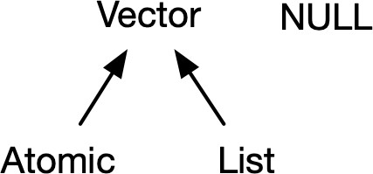
is a Vector Language: Types and Attributes
Vectors come in two flavors, which differ by their elements' types:
atomic vectors -- all elements
must have the same type
lists -- elements can be different
Vector have two important attributes:
Dimension turns vectors into matrices and arrays, checked using dim(object_name).
The class attribute powers the S3 object system, checked using class(object_name).
class(x_vec)
## [1] "numeric"
Source: The content and image are from Hadley Wickham's Advanced R: Chapter 3 on Vectors
23 / 51

Slide 24
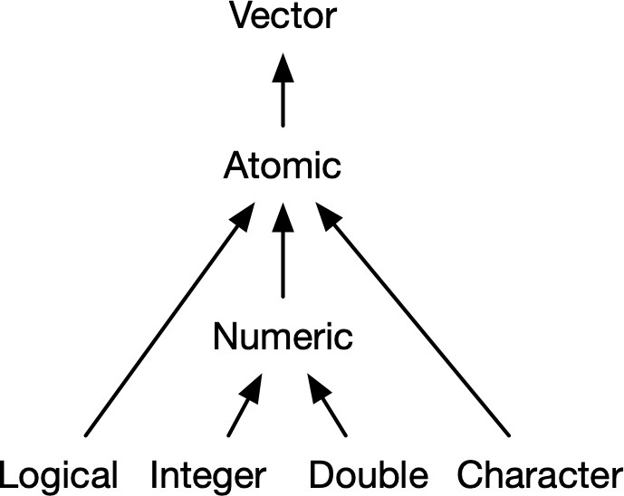
is a Vector Language: Atomic Vectors
dim(x_vec)
## NULL
Atomic vectors have a dim of NULL, which distinguishes it from 1D arrays 🤯!!!
Source: The image is from Hadley Wickham's Advanced R: Chapter 3 on Vectors
24 / 51

Slide 25
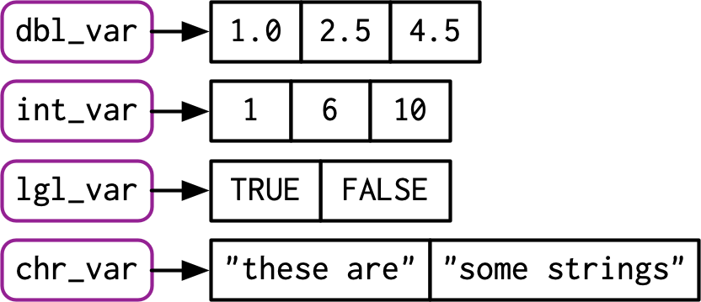
Data Types: A Visual Introduction [1]
To check the type of an object in , you can use the function typeof:
typeof(x_vec)
## [1] "double"
Source: The image is from Hadley Wickham's Advanced R: Chapter 3 on Vectors
25 / 51

Slide 26
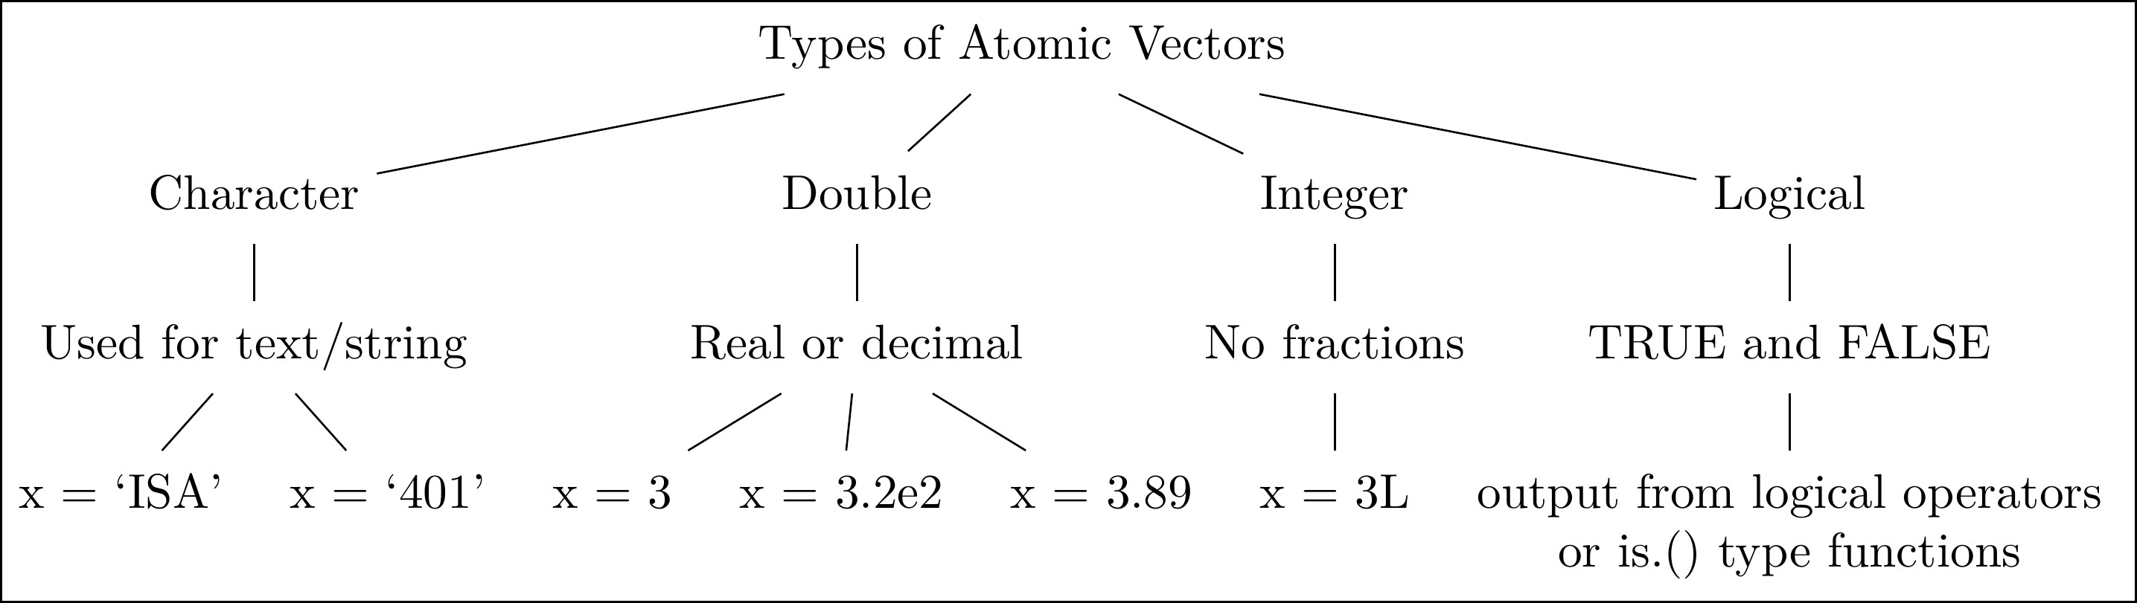
Data Types: A Visual Introduction [2]
The four data types that we will utilize the most in our course.
26 / 51

Slide 27
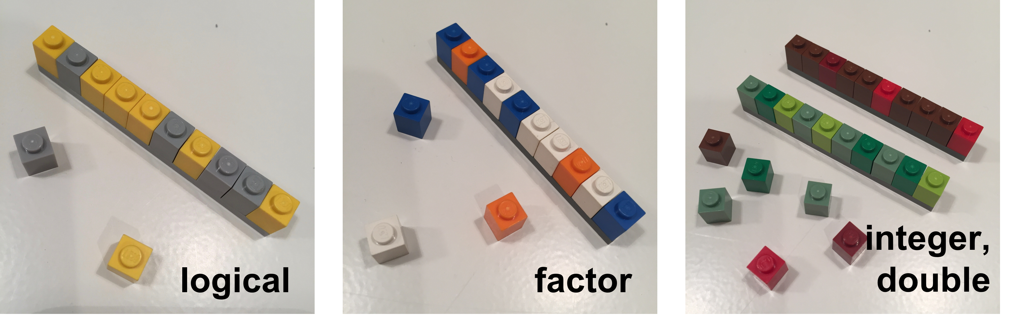
Data Types: A Visual Introduction [3]
A visual representation of different types of atomic vectors
Source: The images are from the excellent lego-rstats GitHub Repository by Jenny Bryan
27 / 51

Slide 28
Data Types: Formal Definitions
Each of the four primary types has a special syntax to create an individual value:
Logicals can be written in full (TRUE or FALSE), or abbreviated (T or F).
Doubles can be specified in decimal (0.1234), scientific (1.23e4), or hexadecimal (0xcafe) form.
There are three special values unique to doubles: Inf, -Inf, and NaN (not a number).
These are special values defined by the floating point standard.
Integers are written similarly to doubles but must be followed by L(1234L, 1e4L, or
0xcafeL), and can not contain fractional values.
Strings are surrounded by " (e.g., "hi") or ' (e.g., 'bye'). Special characters are escaped with \ see ?Quotes for full details.
Source: The content of this slide is verbatim from Hadley Wickham's Advanced R: Chapter 3 on Vectors
28 / 51

Slide 29
Data Structures: Atomic Vector (1D)
Keeping the visual representation of different types of atomic vectors in your head!!
dept = c('ACC', 'ECO', 'FIN', 'ISA', 'MGMT') nfaculty = c(18L, 19L, 14L, 25L, 22L)
Source: The images are from the excellent lego-rstats GitHub Repository by Jenny Bryan
29 / 51

Slide 30
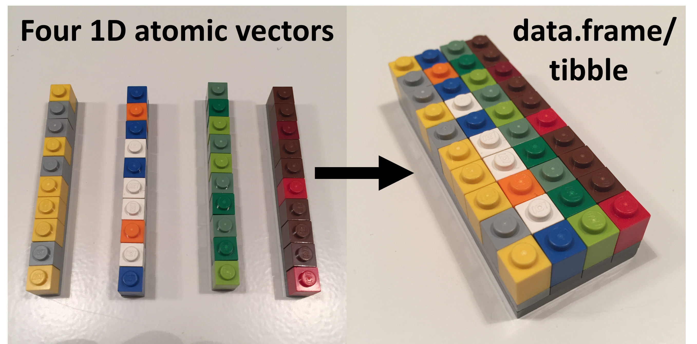
Data Structures: 1D ➡ 2D [Visually]
Source: The images are from the excellent lego-rstats GitHub Repository by Jenny Bryan
30 / 51

Slide 31
Data Structures: 1D ➡ 2D [In Code]
library(tibble)
fsb_tbl <- tibble( department = dept, count = nfaculty,
percentage = count / sum(count))
fsb_tbl
## # A tibble: 5 × 3
## department count percentage
## <chr> |  |  | <int> | <dbl>
## | 1 | ACC | 18 | 0.184
## | 2 | ECO | 19 | 0.194
## | 3 | FIN | 14 | 0.143
## | 4 | ISA | 25 | 0.255
## | 5 | MGMT | 22 | 0.224
31 / 51

Slide 32
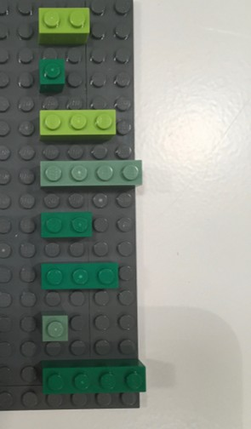
Data Structures: Lists [1]
An object contains elements of different data types.
Source: The image is adapted from the excellent lego-rstats GitHub Repository by Jenny Bryan
32 / 51

Slide 33
Data Structures: Lists [2]
lst <- list( # list constructor/creator
1:3, # atomic double/numeric vector of length = 3
"a", # atomic character vector of length = 1 (aka scalar) c(TRUE, FALSE, TRUE), # atomic logical vector of length = 3 c(2.3, 5.9) # atomic double/numeric vector of length =3
)
lst # printing the list
## [1] "1:3"
## [4] "c(2.3, 5.9)"
"a"
"c(TRUE, FALSE, TRUE)"
Source: Image is from Hadley Wickham's Advanced R: Chapter 3 on Vectors
33 / 51

Slide 34
Data Structures: Lists [3]
data type
data structure
typeof(lst) # primitive type
str(lst)
sublists can be of diff lengths and typ
## [1] "list"
 
## List of 4
data class
## | $ : | int [1:3] | 1 2 3
## | $ : | chr "a"
## | $ : | logi [1:3] TRUE FALSE |  | TRUE
## | $ : | num [1:2] 2.3 5.9
class(lst) # type + attributes
## [1] "list"
Source: Slide is based on Earo Wang's STAT 220 Slides.
34 / 51

Slide 35
Data Structures: Lists [3]
A list can contain other lists, i.e. recursive
a named list str(
list(first_el = lst, second_el = iris)
)
## List of 2
## $ first_el :List of 4 ## ..$ : int [1:3] 1 2 3
## ..$ : chr "a"
## ..$ : logi [1:3] TRUE FALSE TRUE ## ..$ : num [1:2] 2.3 5.9
##
## ## ## ## ##
$ second_el:'data.frame': 150 obs. of 5 variables:
..$ Sepal.Length: num [1:150] 5.1 4.9 4.7 4.6 5 5.4 4.6 5 4.4 4.9 ...
..$ Sepal.Width : num [1:150] 3.5 3 3.2 3.1 3.6 3.9 3.4 3.4 2.9 3.1 ...
..$ Petal.Length: num [1:150] 1.4 1.4 1.3 1.5 1.4 1.7 1.4 1.5 1.4 1.5 ...
..$ Petal.Width : num [1:150] 0.2 0.2 0.2 0.2 0.2 0.4 0.3 0.2 0.2 0.1 ...
..$ Species : Factor w/ 3 levels "setosa","versicolor",..: 1 1 1 1 1 1 1 1 1 1 ...
35 / 51

Slide 36
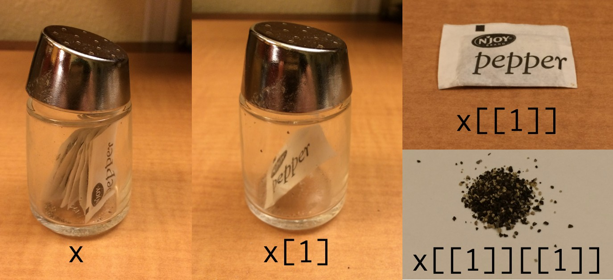
Data Structures: Lists [4]
Subset by []
Subset by [[]]
lst[1]
lst[[1]]
## [[1]]
## [1] 1 2 3
## [1] 1 2 3
Sources: The slide is based on Earo Wang's STAT 220 slides and image is from Hadley Wickham's Tweet on Indexing lists in R.
36 / 51

Slide 37
Data Structures: Matrices
A matrix is a 2D data structure made of one/homogeneous data type.
x_mat = matrix( sample(1:10, size = 4), str(x_mat) # its structure?
x_char = matrix(
sample(letters, size = 12), nrow = 3, n x_char
n
 
 
## int [1:2, 1:2] 5 10 2 4
## [,1] [,2] [,3] [,4]
## [1,] "u" "l" "b" "k"
## [2,] "o" "q" "r" "f"
## [3,] "w" "j" "e" "g"
x_mat # printing it nicely print('-----------------')
x_mat[1, 2] # subsetting
x_char[1:2, 2:3] # subsetting
## [,1] [,2]
## [1,] 5 2
## [2,] 10 4
## [,1] [,2]
## [1,] "l" "b"
## [2,] "q" "r"
## [1] "-----------------"
## [1] 2
37 / 51

Slide 38
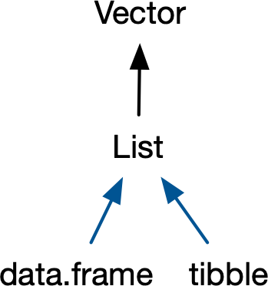
Data Structures: Data Frames [1]
If you do data analysis in R, you’re going to be using data
frames. A data frame is a named list of vectors with attributes for (column) names, row.names, and its class, “data.frame”. -- Hadley Wickham
Source: Image is from Hadley Wickham's Advanced R: Chapter 3 on Vectors
38 / 51

Slide 39
Data Structures: Data Frames [2]
df1 <- data.frame(x = typeof(df1) # showing |  | 1:3, that | y = letters[1:3]) its a special case of a list
## [1] "list"
attributes(df1) # but |  | also | is of class data.frame
## | $names
## ## ## | [1] "x" "y" $class
## ## ## | [1] "data.frame" $row.names
## | [1] 1 2 3
In contrast to a regular list, a data frame has an additional constraint: the length of each of its vectors must be the same. This gives data frames their rectangular structure.
Source: Content is from Hadley Wickham's Advanced R: Chapter 3 on Vectors
39 / 51

Slide 40
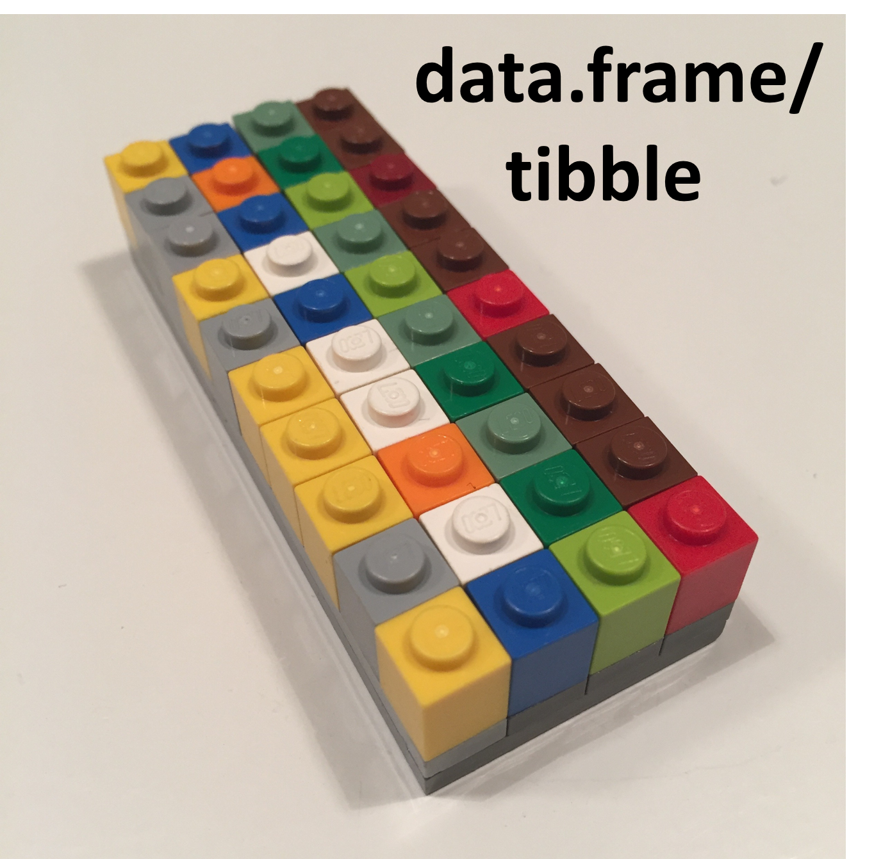
Data Structures: Data Frames [3]
As noted in the creation of df1, columns in a data frame can be of different types. Hence, it is more widely used in data analysis than matrices.
Source: The image is adapted from the excellent lego-rstats GitHub Repository by Jenny Bryan
40 / 51

Slide 41
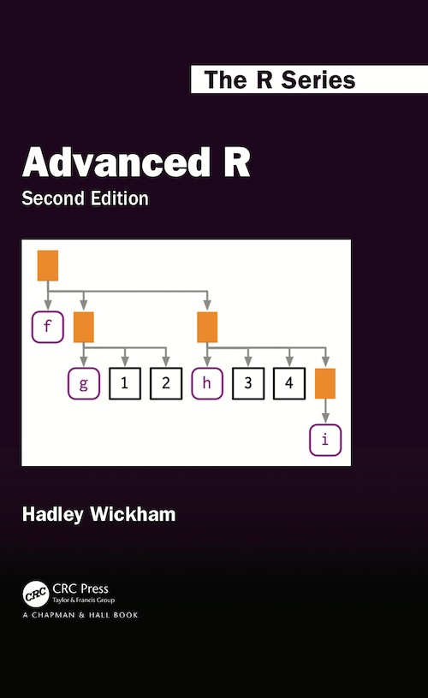
Data Structures: So What is a Tibble Anyway?
Tibble is a modern reimagining of the data frame. Tibbles are designed to be (as
much as possible) drop-in replacements for data frames that fix those frustrations. A concise, and fun, way to summarise the main differences is that tibbles are lazy and surly: they do less and complain more. -- Hadley Wickham
To learn more about the basics of tibble, please consult the reference below:
Data frames and tibbles (Click and read from 3.6 up to and including 3.6.5)
41 / 51

Slide 42
Functions
A function call consists of the function name followed by one or more argument within parentheses.
temp_high_forecast = c(86, 84, 85, 89, 89, 84, 81) mean(x = temp_high_forecast)
## [1] 85.42857
function name: mean(), a built-in R function to compute mean of a vector
argument: the first argument (LHS x) to specify the data (RHS temp_high_forecast)
Source: Slide is based on Earo Wang's STAT 220 Slides
42 / 51

Slide 43
02:00
Function Help Page
Check the function's help page with ?mean
Class Activity
Please take 2 minutes to investigate the help page for mean in R Studio.
mean(x = temp_high_forecast, trim = 0, na.rm = FALSE, ...)
Read Usage section
What arguments have default values?
Read Arguments section
What does trim do?
Run Example code
Source: Slide is based on Earo Wang's STAT 220 Slides
43 / 51

Slide 44
Function Arguments
Match by positions
Match by names
mean(temp_high_forecast, 0.1, TRUE)
mean(x = temp_high_forecast, trim = 0.1,
 
## [1] 85.42857
## [1] 85.42857
Source: Slide is based on Earo Wang's STAT 220 Slides
44 / 51

Slide 45
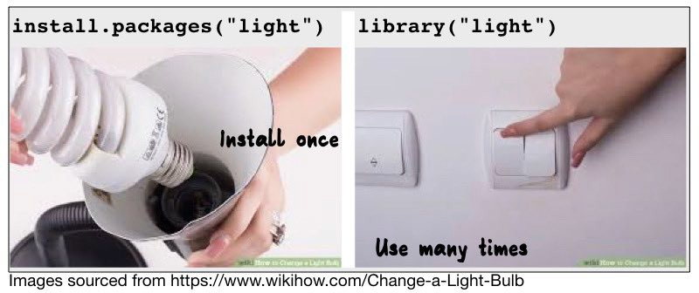
Use Functions from Packages
dplyr::cummean(temp_high_forecast)
## [1] 86.00000 85.00000 85.00000 86.0000
 
dplyr::first(temp_high_forecast)
## [1] 86
dplyr::last(temp_high_forecast)
## [1] 81
Source: Slide is based on Earo Wang's STAT 220 Slides
45 / 51

Slide 46
Write Your Own Functions
function_name <- function(arguments) { # function_body
}
my_mean <- function(x, na.rm = FALSE) { summation <- sum(x, na.rm = na.rm) summation / length(x)
}
my_mean(temp_high_forecast)
## [1] 85.42857
Source: Slide is based on Earo Wang's STAT 220 Slides
46 / 51

Slide 47
DDeemmoo
4477 // 5511

Slide 48
Your First
Script File
Refer to our in class code.
48 / 51

Slide 49
RReeccaapp
4499 // 5511

Slide 50
Summary of Main Points
By now, you should be able to do the following:
Describe why we are using in this course?
Understand the syntax, data structures and functions.
Utilize the project workflow in and create your first
script.
50 / 51

Slide 51
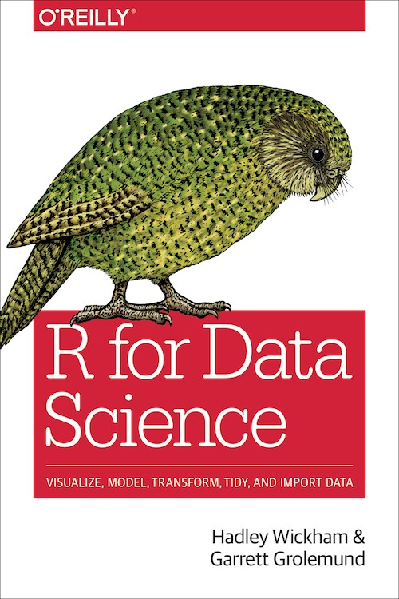
Things to Do to Prepare for Our Next Class
Go over your notes, read the references below, and complete the self-paced R tutorial.
Complete Assignment 02 on Canvas.
Workflow: basics
Workflow: scripts
Workflow: project
Names and values
Vectors
Subsetting
51 / 51

